Slide 1
Transect survey
Dr. Pranjit Kumar Sarma

Slide 2
Transect survey
A transect is a line following a route along which a survey or observations are made.
The transect is an important geographic tool for studying changes in human and/or physical characteristics from one place to another.
An urban transect, usually following a street or several streets, may show changes in land use, the nature of buildings such as houses and shops, or features such as schools, churches, community centres, and parks.
A rural transect might follow a road, section line, or stream, and show the kinds of crops in adjoining fields, farm buildings, vegetation, or changing features along a riverbank.

Slide 3
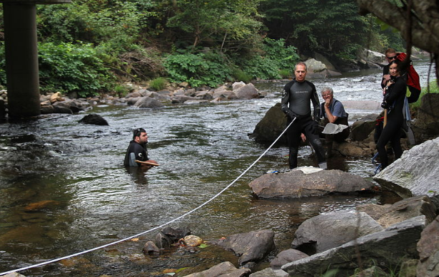
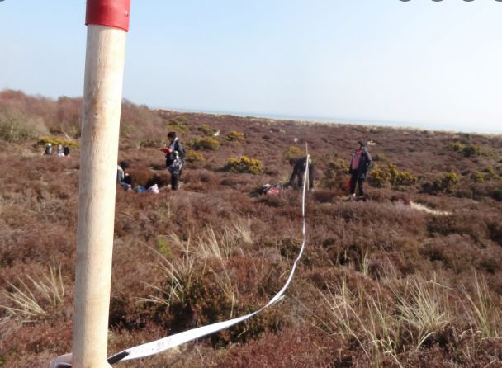
Transect survey
Transects may show features that are along the actual line selected (line transect) or, more commonly, may show what is on either side of the line (belt transect).
Depending on the kinds of features being observed, transects can be a single straight line, straight line segments, or curved lines.

Slide 4
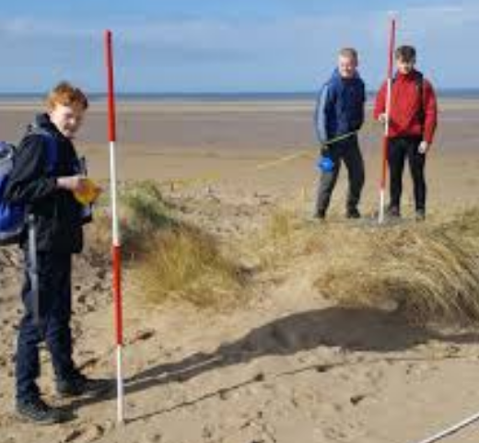
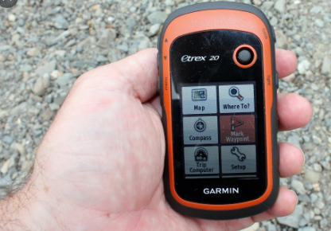
Procedures of Transect survey
Planning:
  Select the transect route carefully and identify the start and end points and take the GPS Coordinates. It is important to be familiar with the transect route to ensure that it passes through a variety of zones so that the completed transect will provide meaningful information.

Slide 5
Procedures of Transect Survey
Mapping:
  Once the route has been selected, it should be drawn carefully on an appropriate map of the area of interest. Then, follow the route and, on the field copy of the map, note the features that you see as you progress along the selected line. This will be the first draft of your transect. It’s a good idea to write brief notes on what you see along the way to ensure that you have all the information you will need to complete the transect.

Slide 6
Procedures of Transect Survey
Creating:
  Now it’s time to prepare the final presentation of the transect. Once back in the classroom, copy the route onto a new map and, using appropriate symbols and shading, show the features and changes along the route. Brief notes can be written in appropriate spaces on either side of the features and symbols along your transect route. Make sure that the transect presentation has a title and legend.

Slide 7
Procedures of Transect Survey
Analyzing:
  The completed transect can be used to analyze the changes and the possible relationships between physical and human features along the route. If another student has selected the same route or segment of a route, the two transects can be analyzed in terms of the similarities and differences and the varying perceptions that different people may have of the same area.

Slide 8
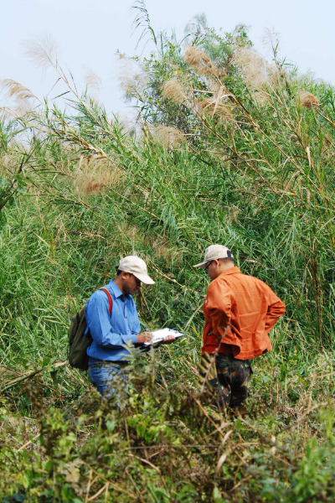
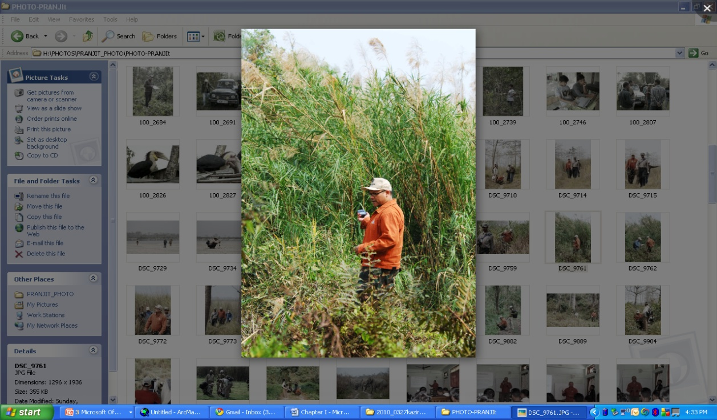
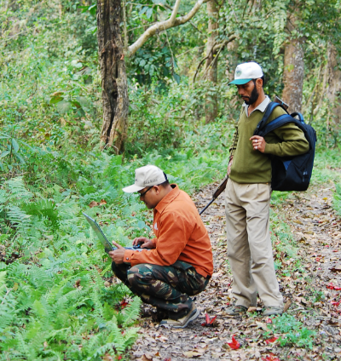
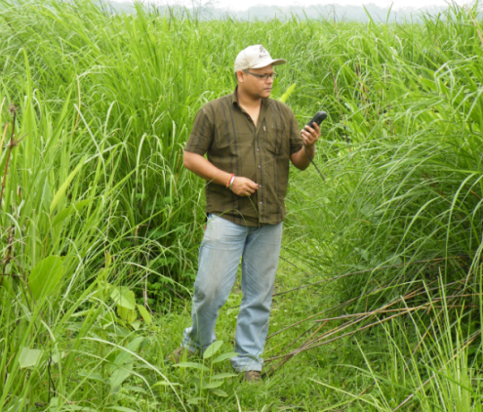
Vegetation Survey Using Transect Method
© pranjit

Slide 9
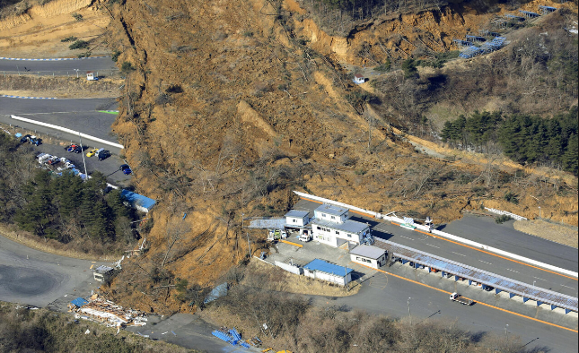
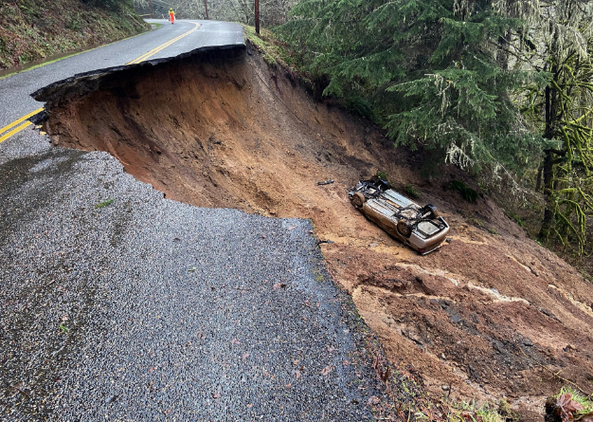
Landslide Area Survey Using Transect Method

Slide 10
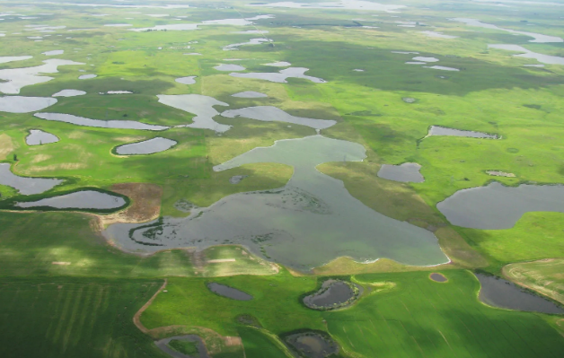
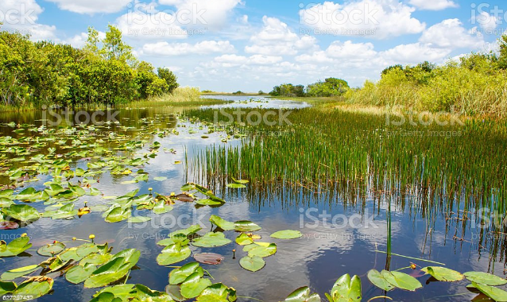
Wetland Survey Using Transect Method

Slide 11
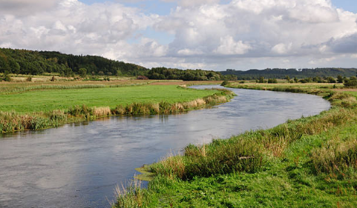
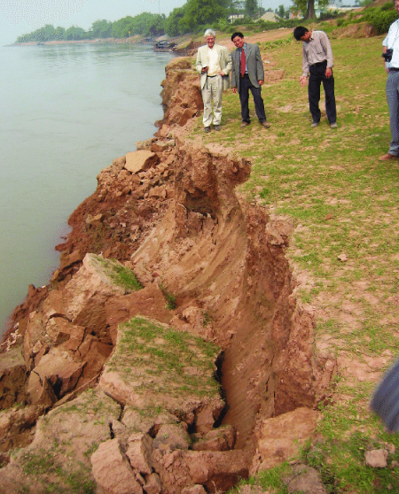
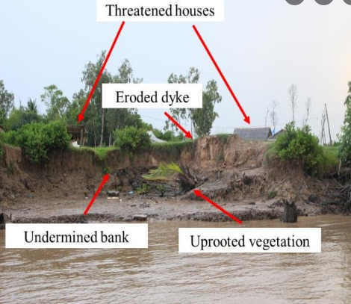
River Bank Survey Using Transect Method

Slide 12
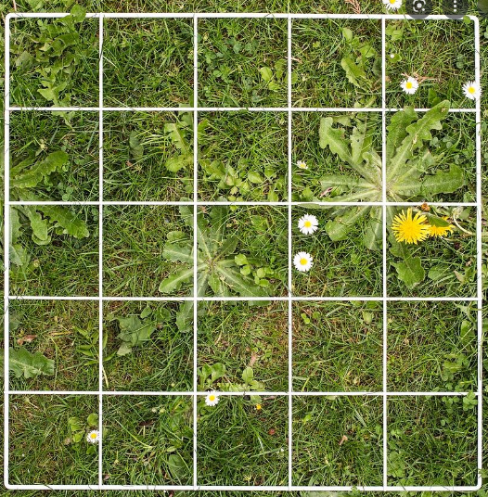
Quadrant Survey
A quadrant is a frame, traditionally square, used in geography, ecology, and biology to isolate a standard unit of area for study of the distribution of an item over a large area.
Modern quadrants can for example be rectangular, circular, or irregular. The quadrant is suitable for sampling plants, slow-moving animals, and some aquatic organisms.

Slide 13
Quadrant Survey
The systematic use of quadrants was developed by the pioneering plant ecologists R. Pound and F. E. Clements between 1898 and 1900.
The method was then swiftly applied for many purposes in ecology, such as the study of plant succession. Botanists and ecologists such as Arthur Tansley soon took up and modified the method.

Slide 14
Quadrant Survey
When a geographer and an ecologist wants to know how many organisms there are in a particular habitat, it would not be feasible to count them all. Instead, they would be forced to count a smaller representative part of the population, called a sample.
Sampling of plants or slowly moving animals (such as snails) can be done using a sampling square called a quadrant.

Slide 15
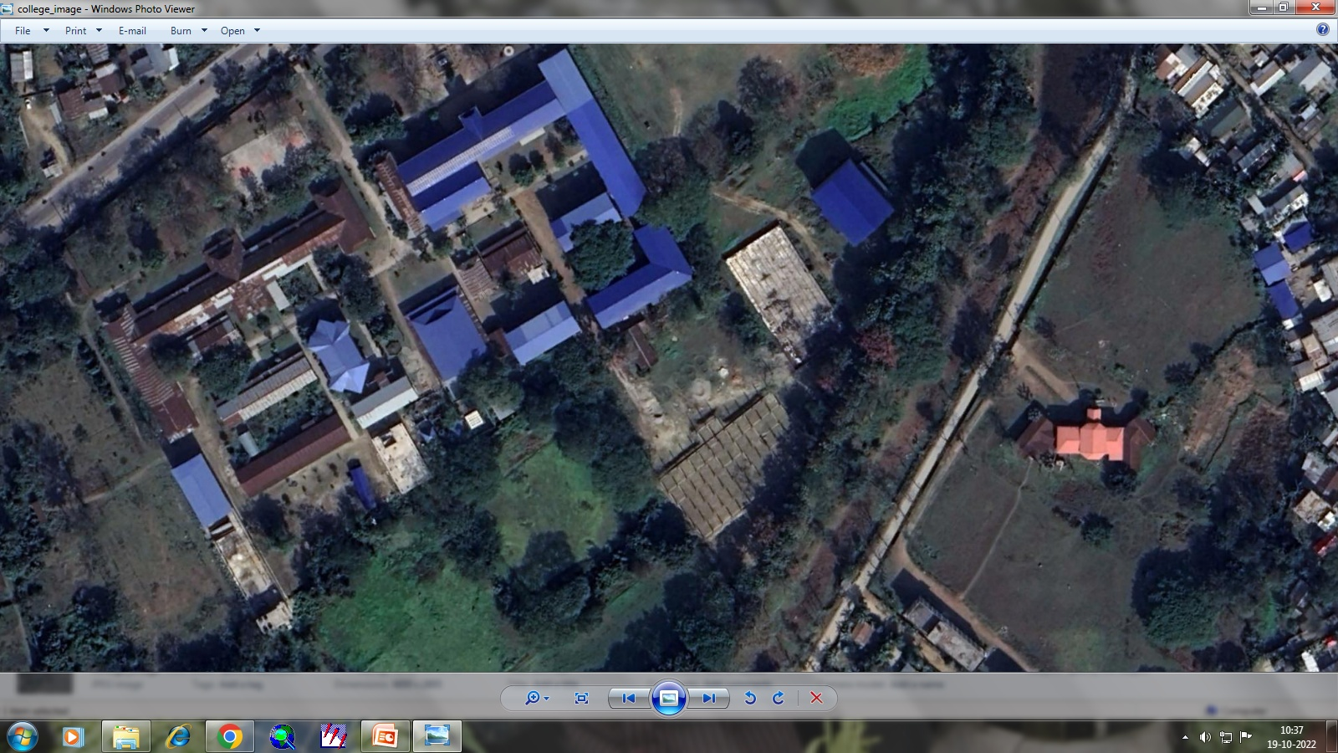
Quadrant Survey
Water spread Area
Plant Diversity
Aquatic Animals
Water Quality
Depth
Pollutant

Slide 16
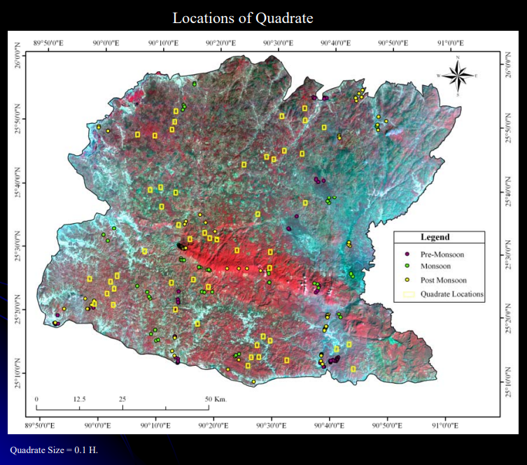
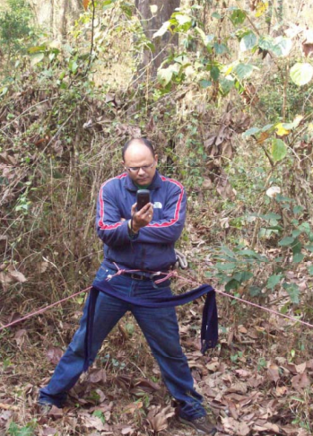
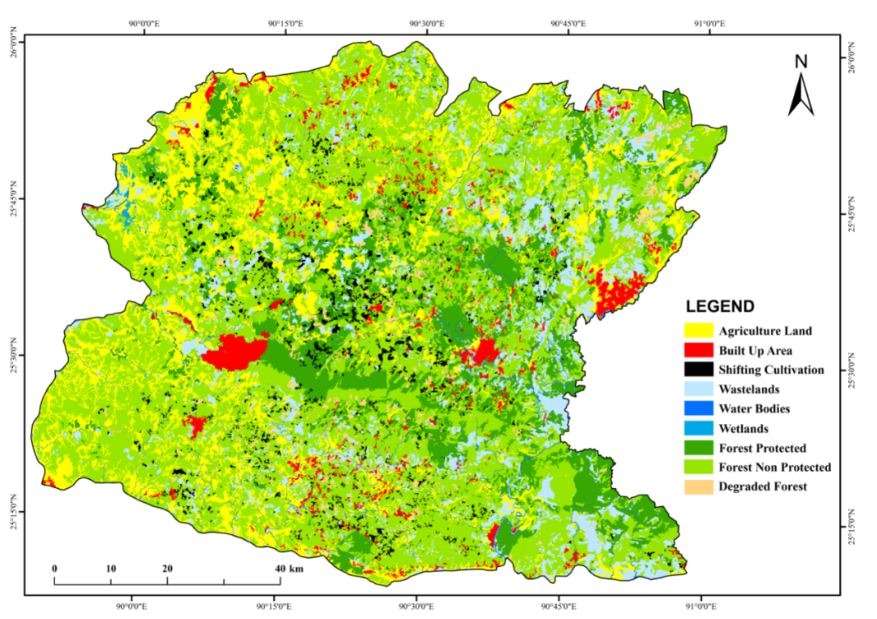
Quadrant Survey

Slide 17
Sketch Map
An outline map drawn from observation rather than from exact survey measurements and showing only the main features of the area.
A sketch map is a rough drawing of an area. It is drawn without scale.
They are simple drawings of the landscape. They show things that are hidden in photographs or maps.

Slide 18
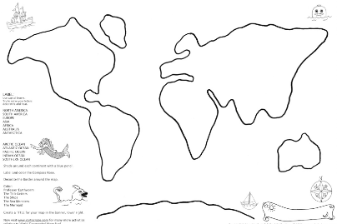
Sketch Map

